Slide 1
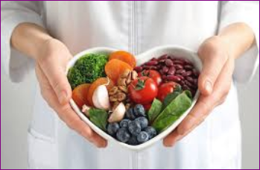
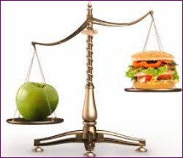
DIET MANAGEMENT APP
A HEARTFUL INTRODUCTION TO BALANCED EATING HABITS
AUTHOR: VALARY AYUMA
DATE: 18TH SEPTEMBER 2024

Slide 2
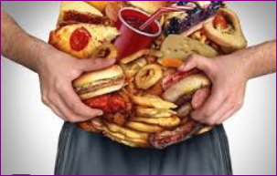

PROBLEM STATEMENT
The Problem:
Increasing rates of obesity and dietary-related illnesses globally.
Lack of awareness about nutritional values and healthy eating.
Significance:
Addressing these issues can lead to improved health outcomes and reduced healthcare costs.
Aligns with global health initiatives and supports sustainable diet practices.

Slide 3

SOLUTION OVERVIEW
Diet Tracker offers a user-friendly platform where individuals can log their meals and track nutrient intake. Additionally, it provides sustainability tips to promote environmentally conscious eating habits. User-friendly interface built with dart with flutter,python with Django and web technology(nodejs,html and MySQL database) for both iOS and Android platforms.

Slide 4
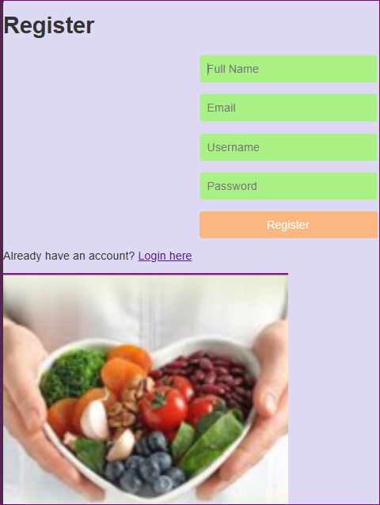
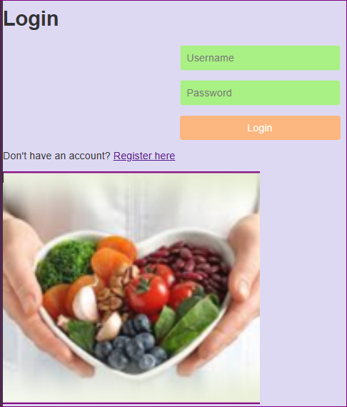
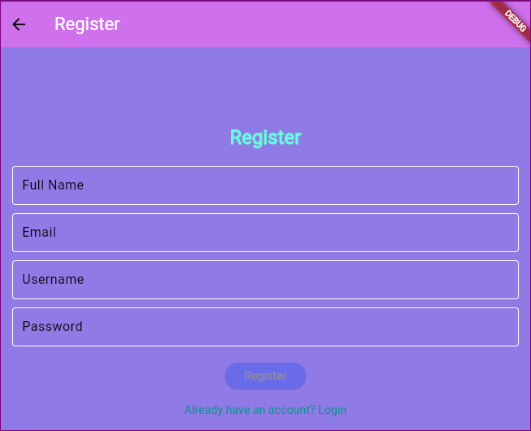
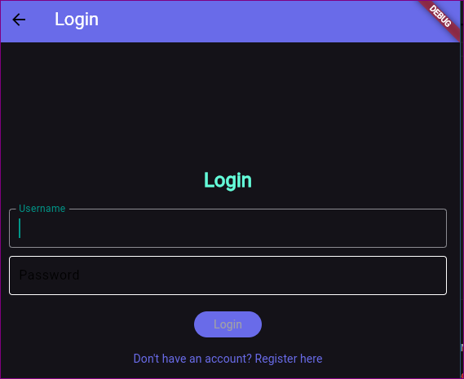
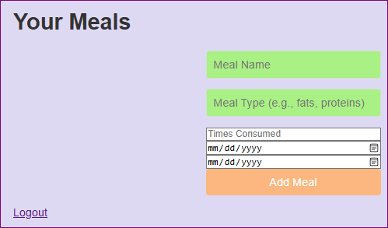
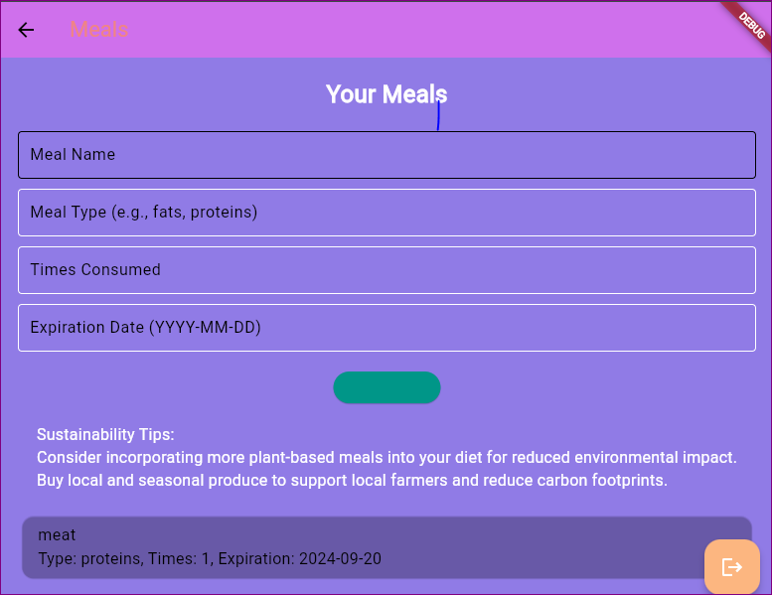
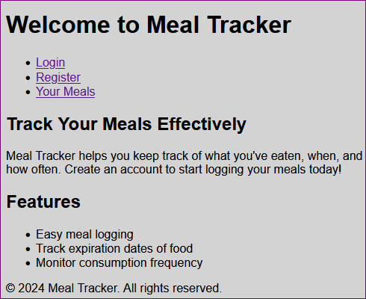
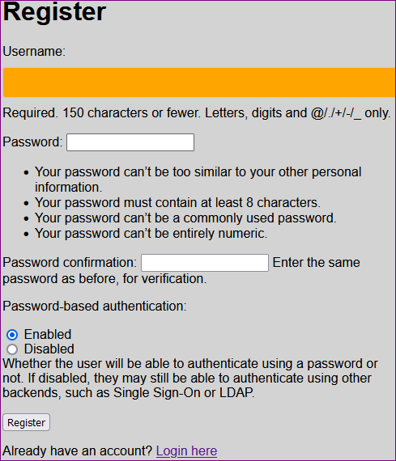
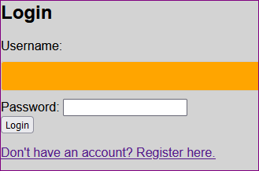
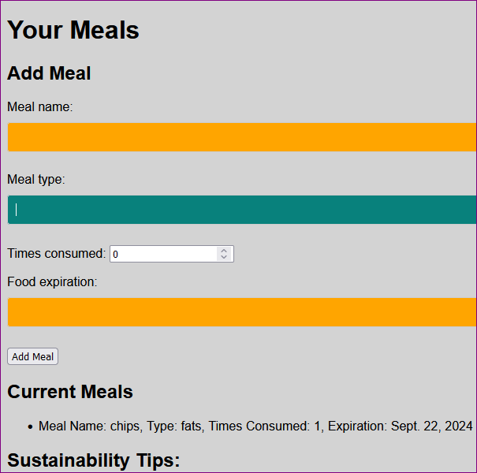
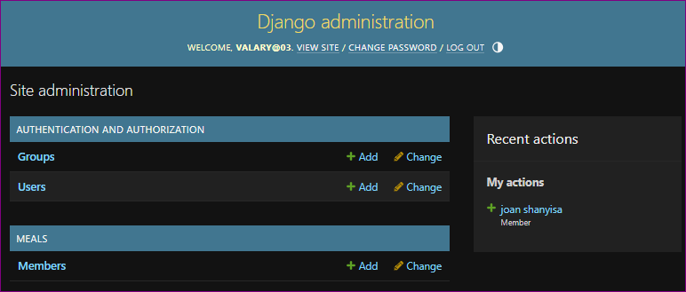
PRODUCTS
Web project screenshots
Let’s take a look at the application in action. Here are some screenshots showing user registration and meal logging.
Dart with flutter screenshots
Python with Django screenshots

Slide 5

TARGET MARKET
Health-conscious individuals aged 18-45.
Families looking to manage nutrition for themselves and their children.
Fitness enthusiasts and individuals with dietary restrictions.

Slide 6
MARKET SIZE
Global health and wellness market projected to reach $500000 by 2026.
Health app market is expected to grow from $4000 in 2024 to $5 million by 2028.
Identified target audience of around 100 million potential users all over the world.

Slide 7
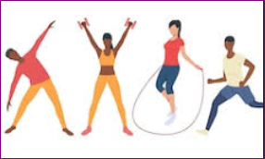
COMPETITORS
Overview of existing diet tracker apps (e.g., MyFitnessPal, Lose It!, Cronometer).

Slide 8
COMPETITIVE ADVANTAGE
Unique focus on food expiration management.
Comprehensive yet intuitive interface designed for seamless user experience.

Slide 9
TRACTION AND ROADMAP
Traction
Successfully completed a beta launch with over [X] active users.
Future roadmap
Launch of additional features like recipe suggestions and advanced analytics.

Slide 10
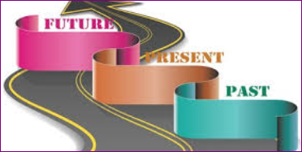
BUSINESS MODEL
We plan on implementing a freemium model, allowing users access to basic features for free while offering premium subscriptions for more advanced tools. Additional revenue can come from targeted advertisements and affiliate marketing.

Slide 11
GO TO MARKET
Digital Marketing: Leverage SEO, social media (Instagram, TikTok), and PPC advertising tailored to health and wellness content.
Influencer Collaborations: Engaging fitness influencers and nutritionists to promote the app through authentic use cases.
Content Marketing: Regular blog posts and webinars on nutrition best practices, meal prep, and health benefits to establish authority and attract users.

Slide 12
OUR TASK
Seeking $ 50000 in seed funding to accelerate development and marketing.
Funds allocated for:
Hiring additional developers and nutrition experts.
Enhancing marketing strategies to increase user acquisition.
Expanding the product roadmap and feature set.

Slide 13
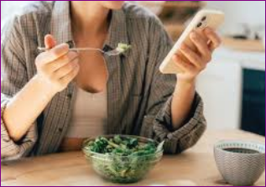

THE TEAM
Our team of 5 experts includes 1 experienced Dart with flutter programmer, 1 python with django, 2 DevOps engineer, and 1 web developer.

Slide 14
THANK YOU
Thank you for your time! We believe Diet Tracker can transform how we approach dietary health. If you have any questions or feedback, please feel free to reach out.
Contact Information;
Email: valaryayuma03@gmail.com
Contact: +254 757 184 454.

